Slide 1
NeRF Variations
CS276: computer photography

Slide 2
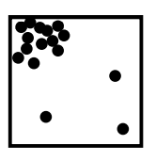
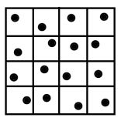
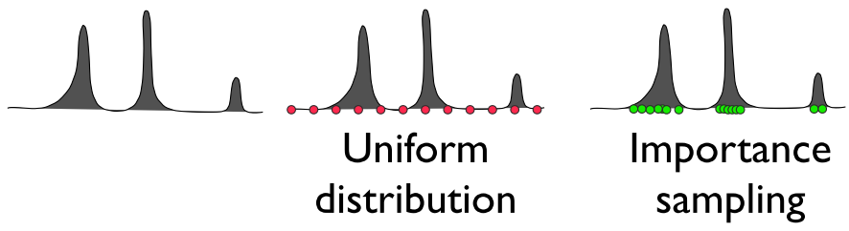
Sampling Strategies
Monte Carlo Integral.
Stratified sampling.
Importance sampling.

Slide 3
Limitations
Extremely slow for rendering and training
Bad Surface reconstruction
Cannot model reflection and refraction well
Hard to edit the local area
Hard to do relighting / defocus
…

Slide 4
Limitations
Extremely slow for rendering and training
Bad Surface reconstruction
Cannot model reflection and refraction well
Hard to edit the local area
Hard to do relighting / defocus
…

Slide 5
Overview
Acceleration
PlenOctrees
Plenoxel
TensoRF
Instant-NGP
Mobile NeRF
NeRF in the Dark
Ref-NeRF
NeRF in the Wild
PhasoRF

Slide 6
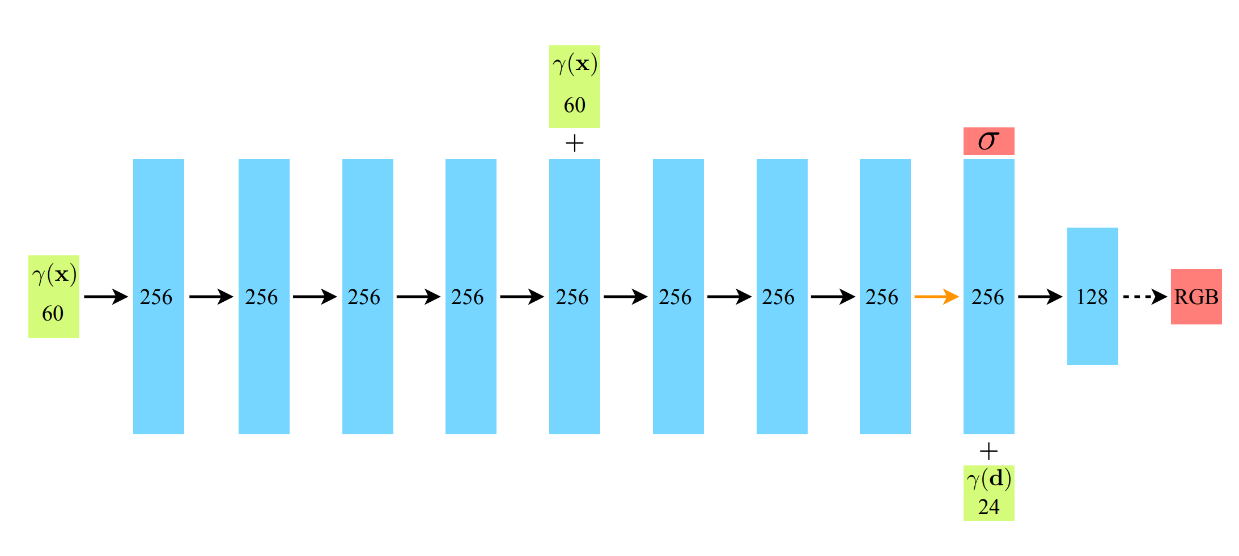
Limitations
About 1–2 days training
About 30 seconds rendering a 800x800 frame
Why so slow?
$800×800×\left(64+ 64+128\right)≈150$millions Deep network queries

Slide 7
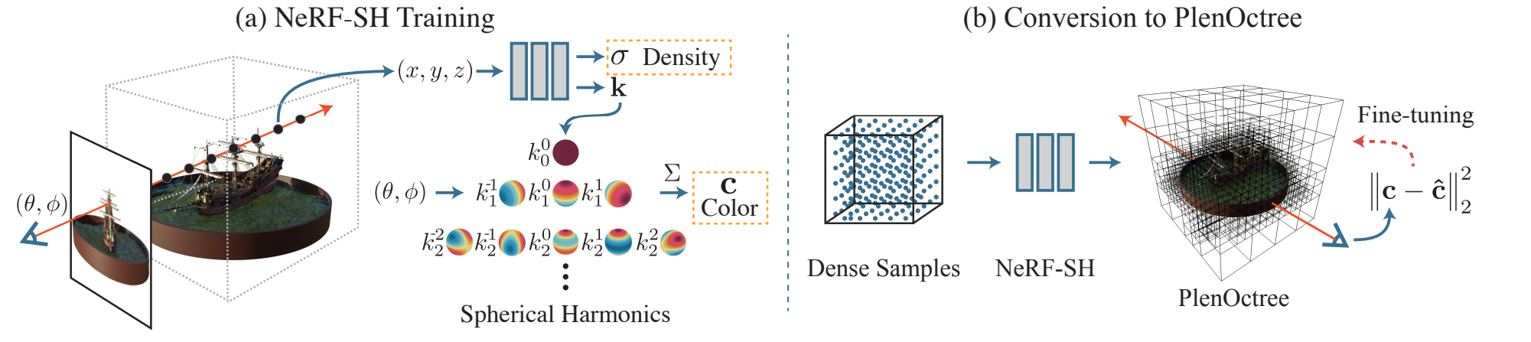
PlenOctrees
Cache the network output!
$F_{Θ}\left(x,y,z,θ,φ\right)=(σ,c)$
Space versus Time
PlenOctrees for Real-time Rendering of Neural Radiance Fields

Slide 8
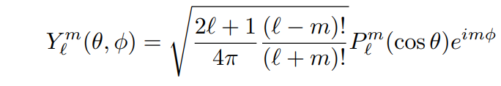
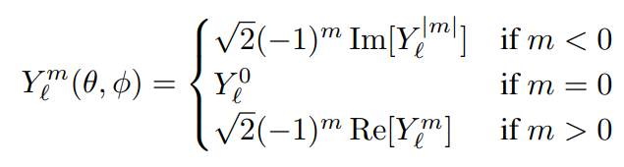
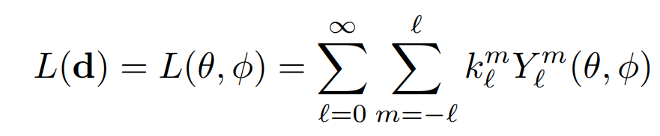
Spherical Harmonic
Cache the 5D function $F_{Θ}\left(x,y,z,θ,φ\right)=(σ,c)$
Better solution?
Real SH functions —— a complete basis of functions$: 𝕊^{2}↦ℝ$

Slide 9
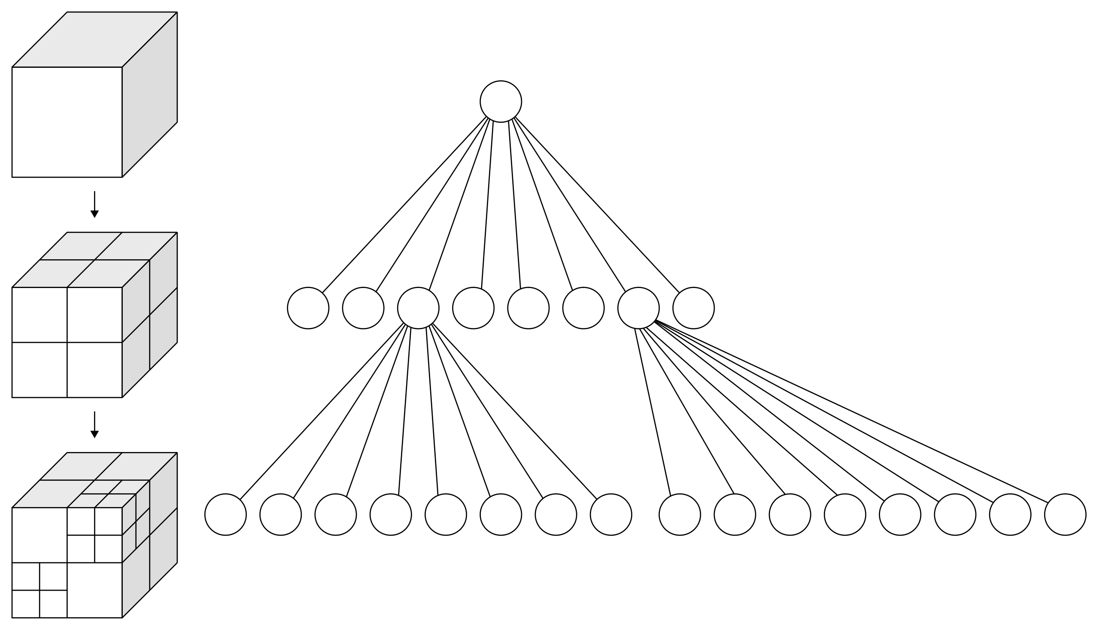
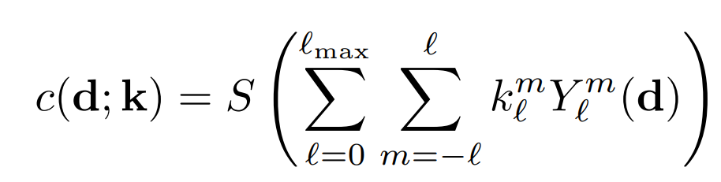
Spherical Harmonic
Cache the 3D function $F_{Θ}\left(x,y,z\right)=(σ,k)$
Convert to Octree
Density thresholding
Sampling points in non-empty grid & average $σ,k$

Slide 10
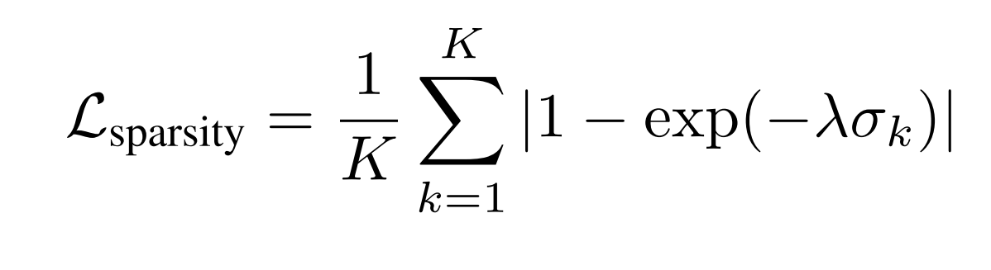
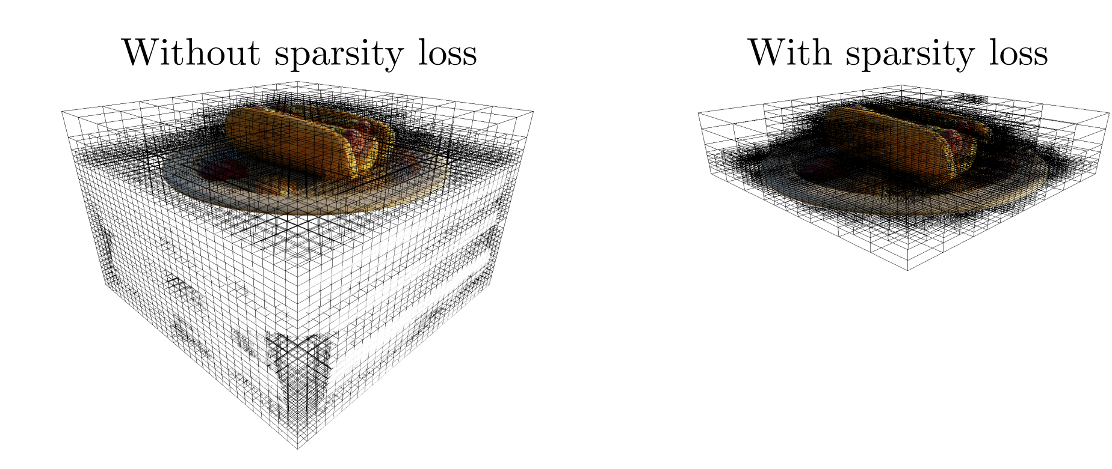
PlenOctrees
Sparsity prior
Encourage empty space
unobserved regions, background

Slide 11
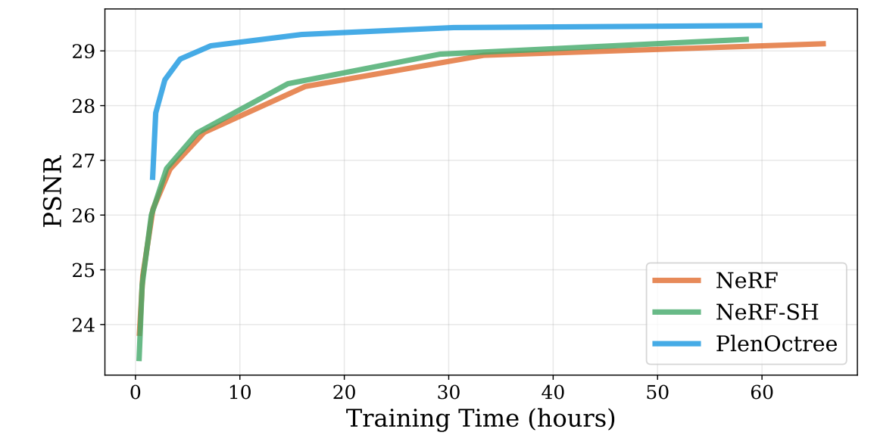

PlenOctrees
Real time rendering!
150 fps (depend on scene)
Rendering is still differentiable
Early stop & fine-tune
DEMO

Slide 12
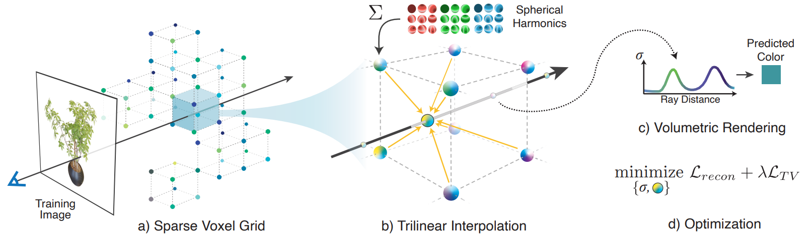
Plenoxels
Rendering is still differentiable
Directly optimize sparse voxel
Course to fine
Trilinear interpolation
Density thresholding
Refine & upsampling
Plenoxels: Radiance Fields without Neural Networks

Slide 13
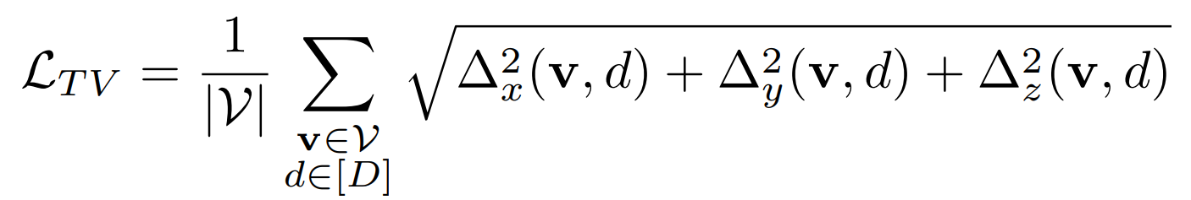
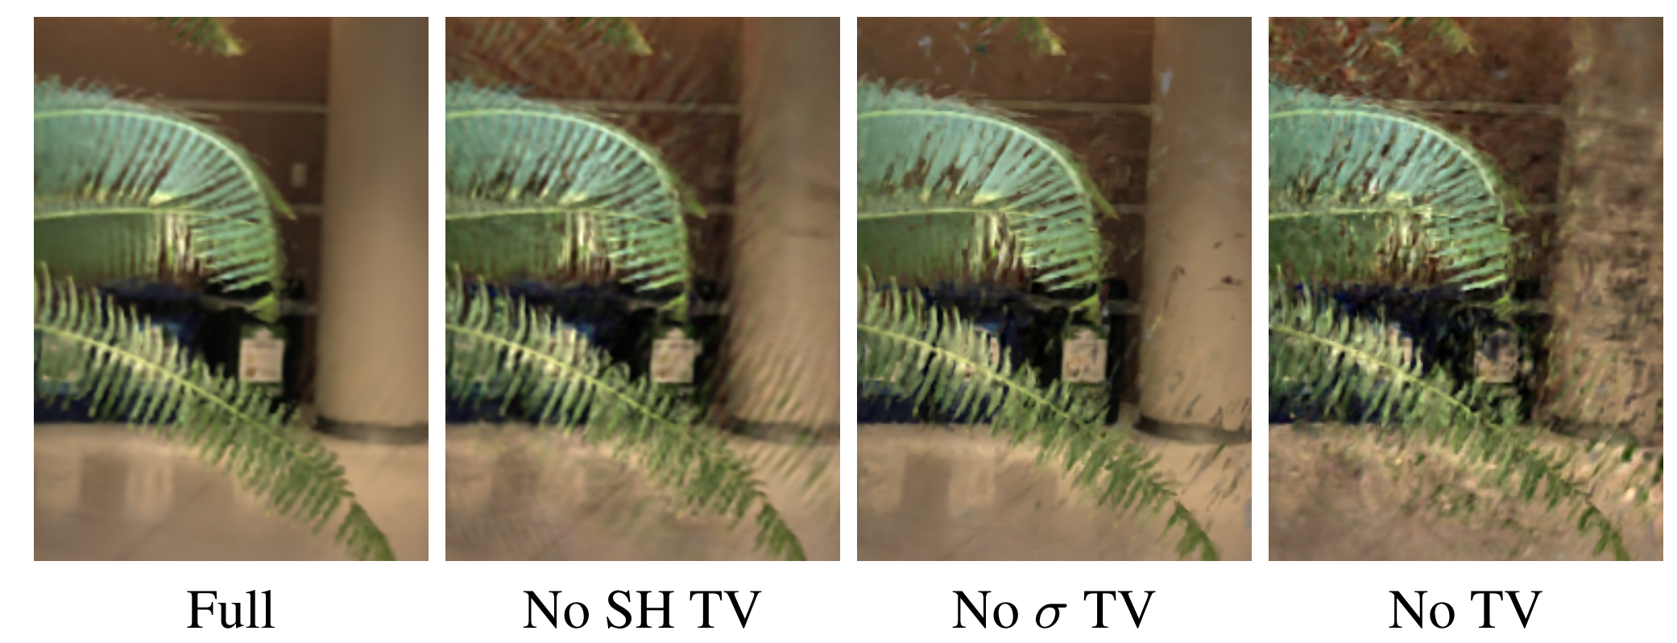
Over-parameterized
a ${300}^{3}$grid with 27 channels has >700M parameters
one hundred 800 × 800 images provide only 64M pixels
TV loss

Slide 14

Plenoxels
15 fps
can convert to a Plenoctree for higher rendering speed
Space versus Time
Plenoctree ~2GB
Plenoxel ~700MB

Slide 15
PlenOctrees & Plenoxels
For now we have satisfying training speed and real time rendering
10 mins training (plenoxel)
150 fps (plenoctree)
Space versus Time
Plenoctree ~2GB
Web renderer version,(median-cut algorithm & DEFLATE algorithm)
34-125MB at the cost of 0.5-1.5 dB in PSNR
Plenoxel ~700MB
Can we do better?

Slide 16
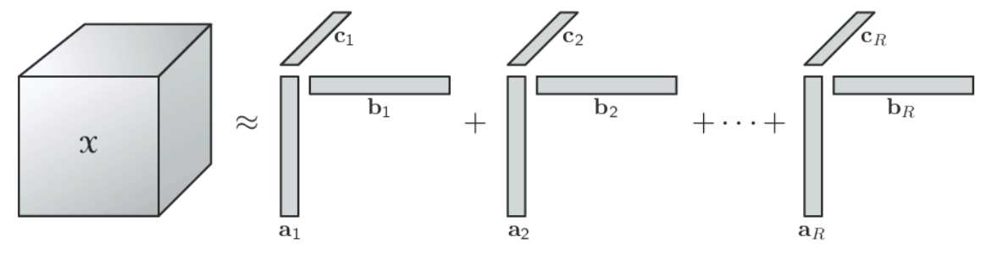
TensoRF
We want a more compact representation
Fewer parameters
Storage efficiency
Reduce over-parameterized problem
Low rank constraints
TensoRF: Tensorial Radiance Fields

Slide 17
Tensor decomposition
Tensor – multidimensional array
Vector – 1 dimension array
Matrix – 2 dimension array
CP decomposition
$𝒳= \sum_{r=1}^{R}{{\text{v}}_{r}^{1}∘{\text{v}}_{r}^{2}{∘\text{v}}_{r}^{3} }, 𝒳_{ijk}= \sum_{r=1}^{R}{{\text{v}}_{r,i}^{1}{\text{v}}_{r,j}^{2}{\text{v}}_{r,k}^{3}}$
The minimal R is called the rank of$𝒳$

Slide 18
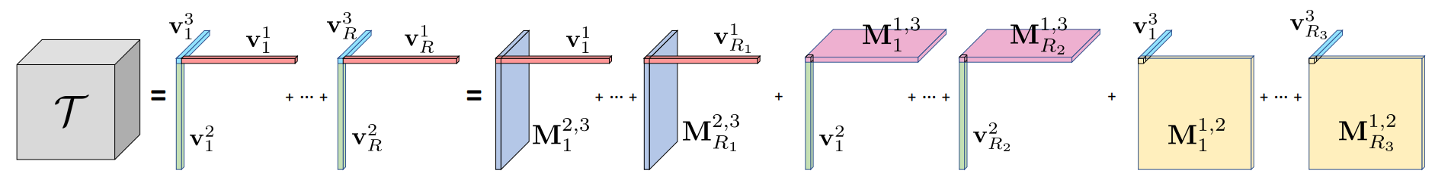
Tensor decomposition
CP decomposition
$𝒯= \sum_{r=1}^{R}{{\text{v}}_{r}^{1}∘{\text{v}}_{r}^{2}{∘\text{v}}_{r}^{3} }$
VM decomposition
$𝒯=\sum_{r=1}^{R_{1}}{{\text{v}}_{r}^{1}∘M_{r}^{2,3}+ \sum_{r=1}^{R_{2}}{{\text{v}}_{r}^{2}∘M_{r}^{1,3}+ \sum_{r=1}^{R_{3}}{{\text{v}}_{r}^{3}∘M_{r}^{1,2} }}}$

Slide 19
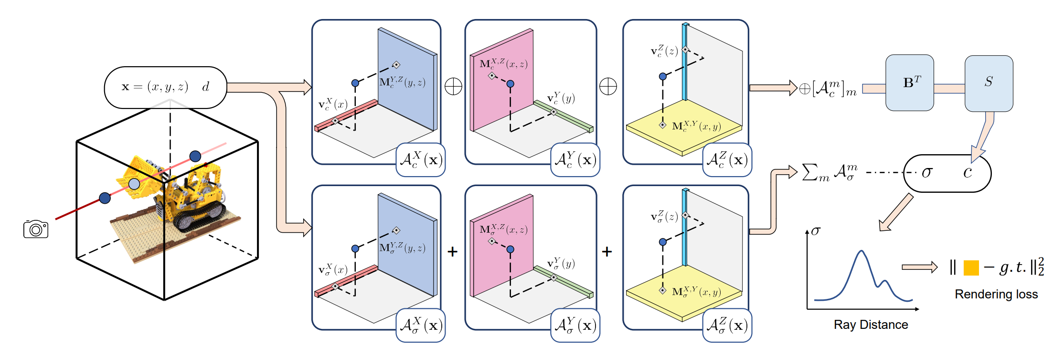
TensoRF
Density $𝒢_{σ}^{I×J×K}$
Color features $𝒢_{c}^{I×J×K×R}$
decoding function $𝒮$
Small MLP
SH functions

Slide 20
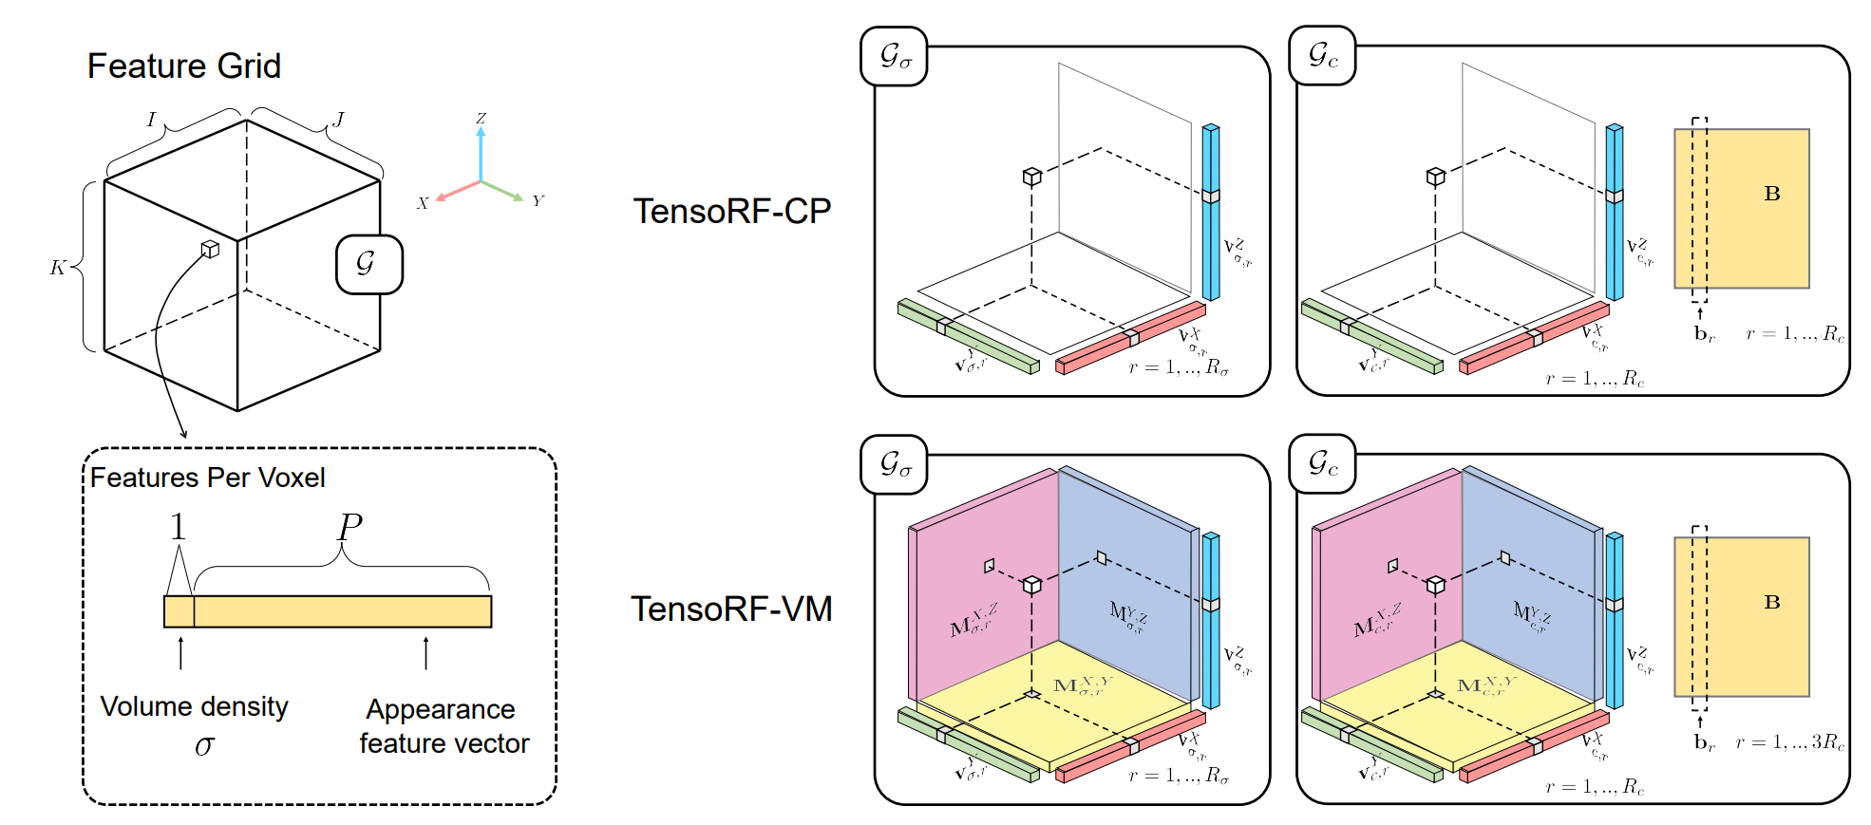
TensoRF
Density $𝒢_{σ}^{I×J×K}$
Color features $𝒢_{c}^{I×J×K×R}$

Slide 21
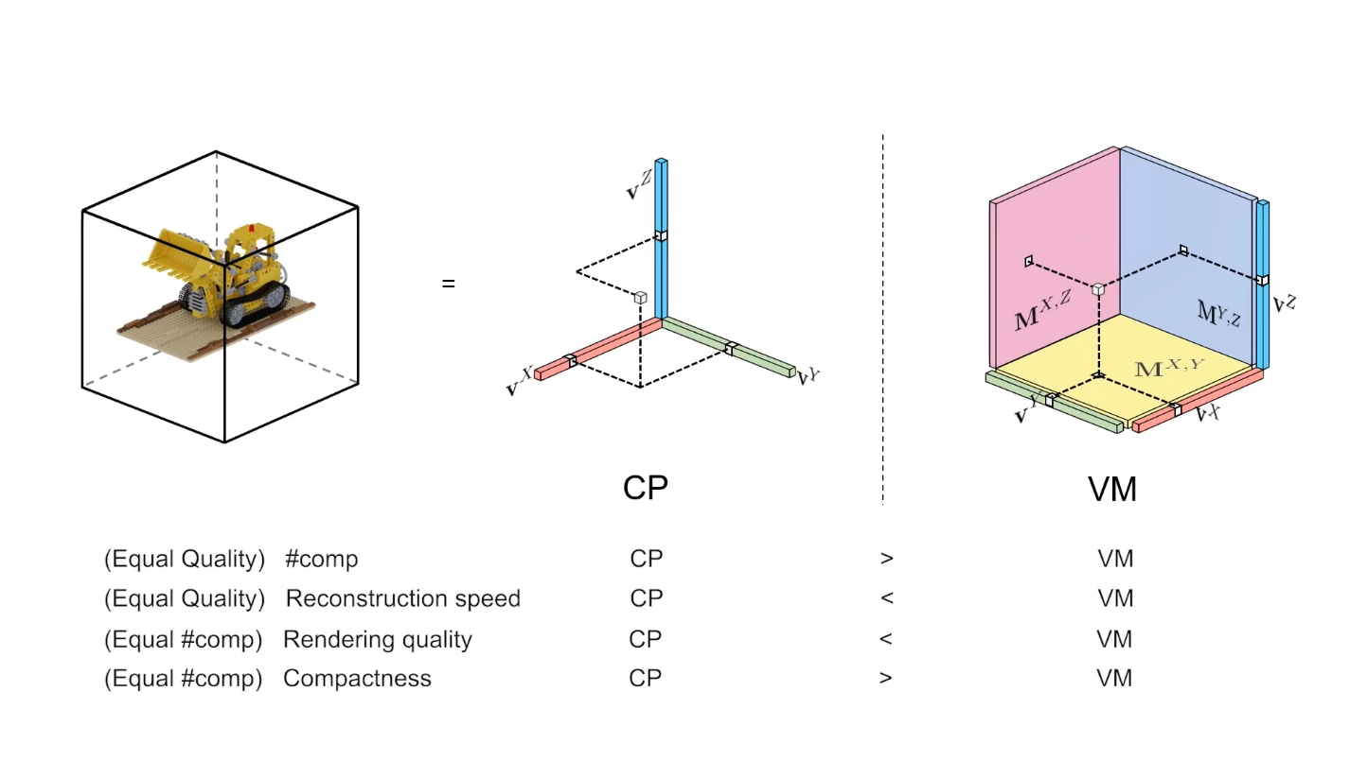
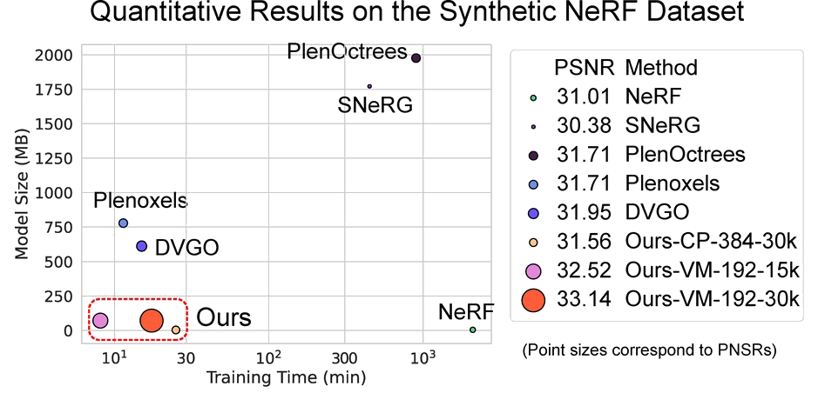
TensoRF
Similar regularization in PlenOctrees & Plenoxels
TV loss
L1 sparsity loss
Coarse-to-fine reconstruction

Slide 22
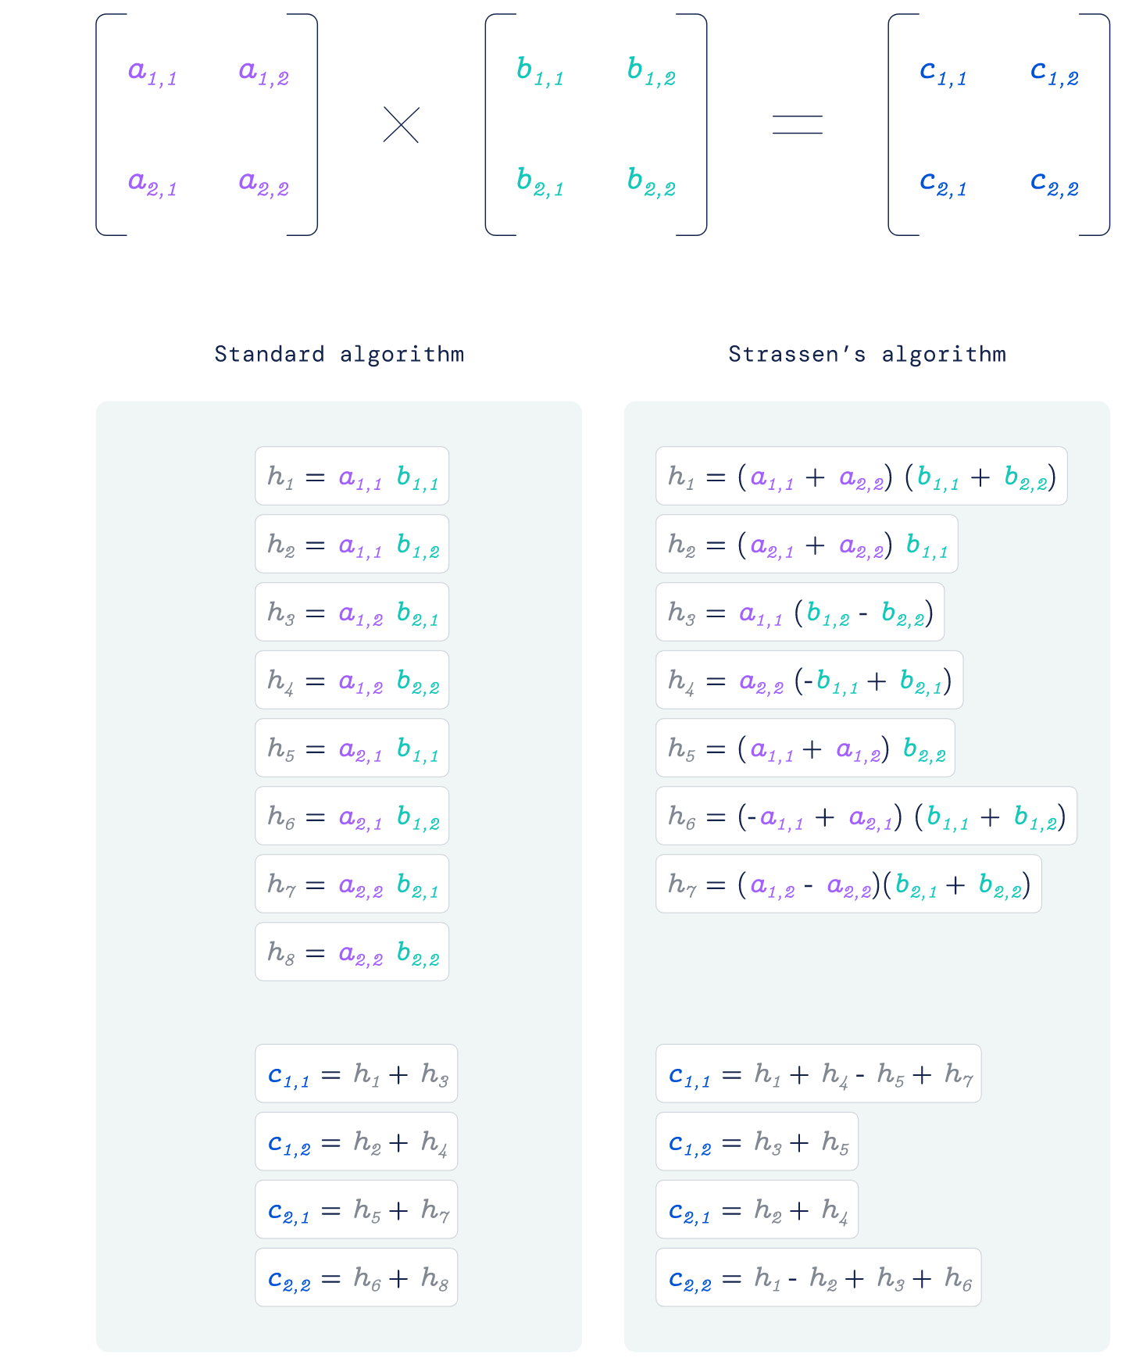
Discovering faster matrix multiplication algorithms with reinforcement learning

Slide 23
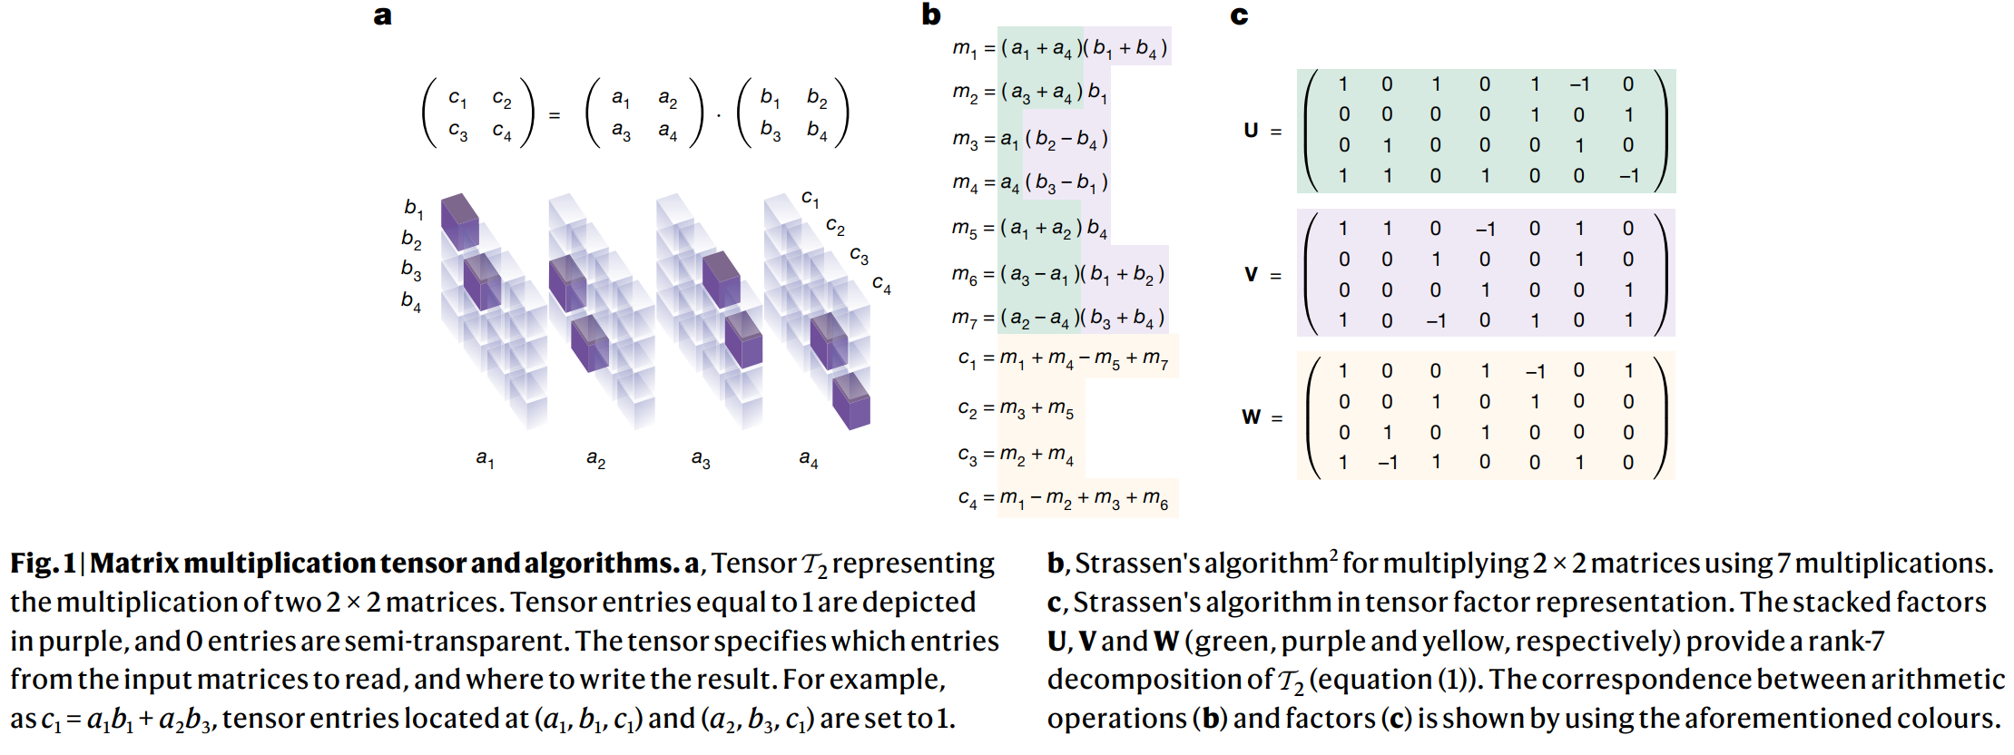
Represent matrix multiplication with tensor
Get efficient matrix multiplication algorithms from tensor decomposition!
Apply reinforcement learning to do decomposition tensor

Slide 24
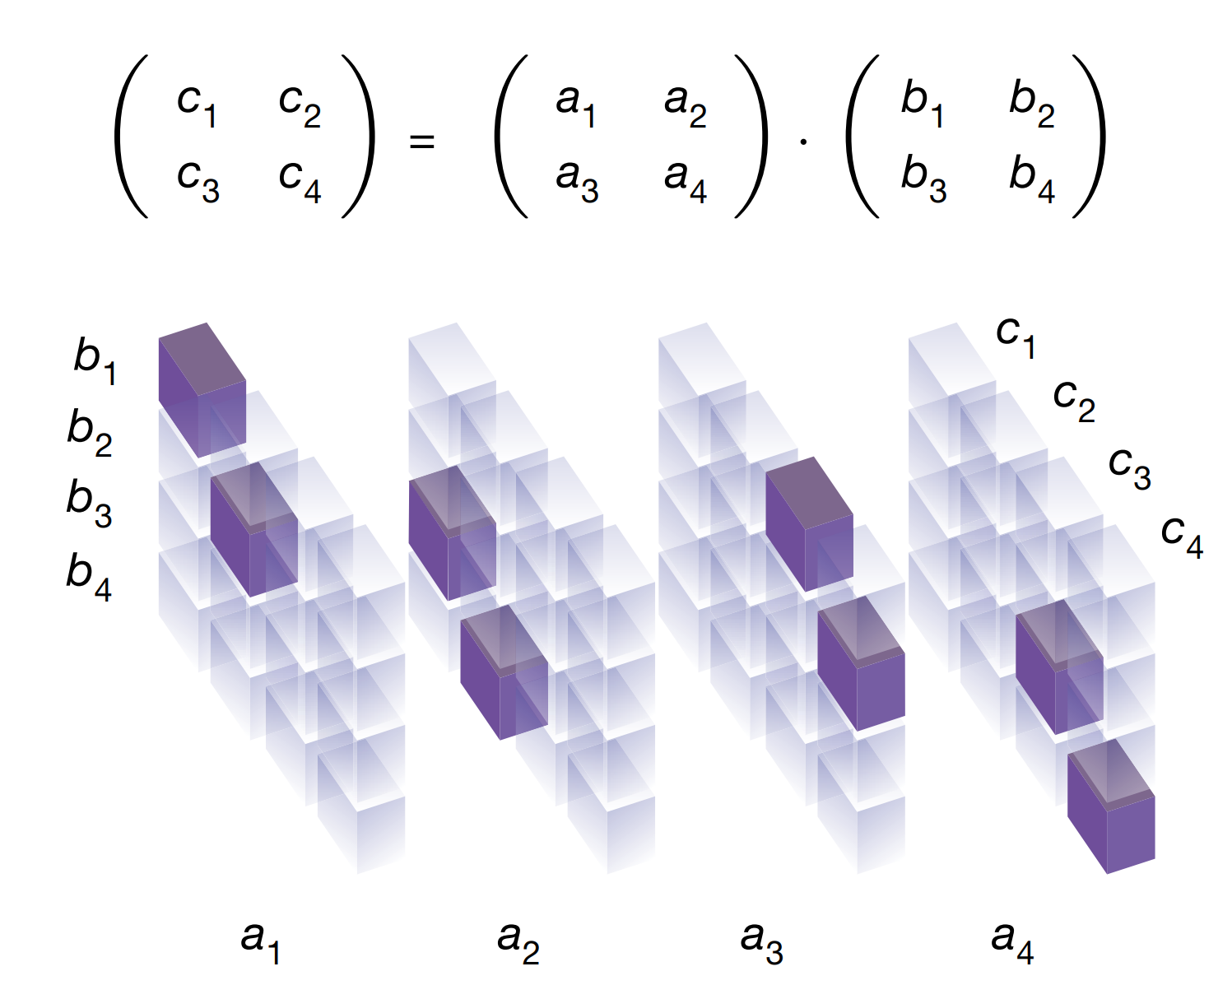
represent the 2 × 2 matrix multiplication operation as a 3D tensor of size 4 × 4 × 4

Slide 25
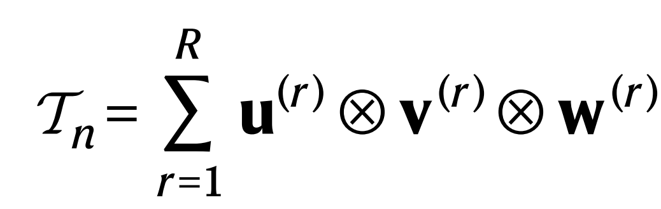
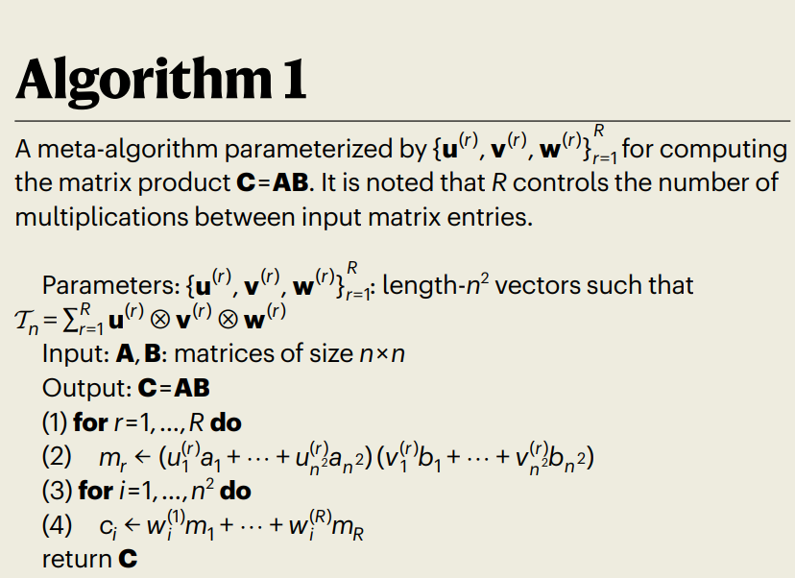
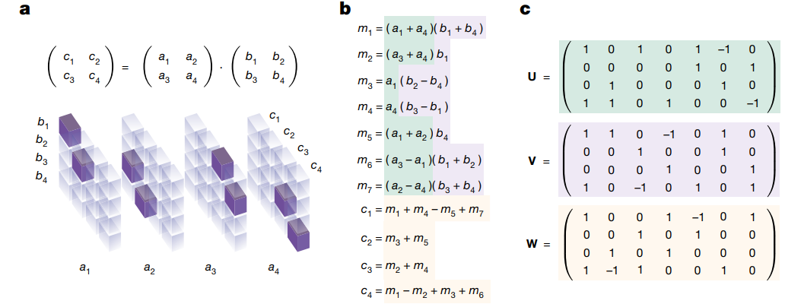
Get matrix multiplication algorithms from tensor decomposition

Slide 26
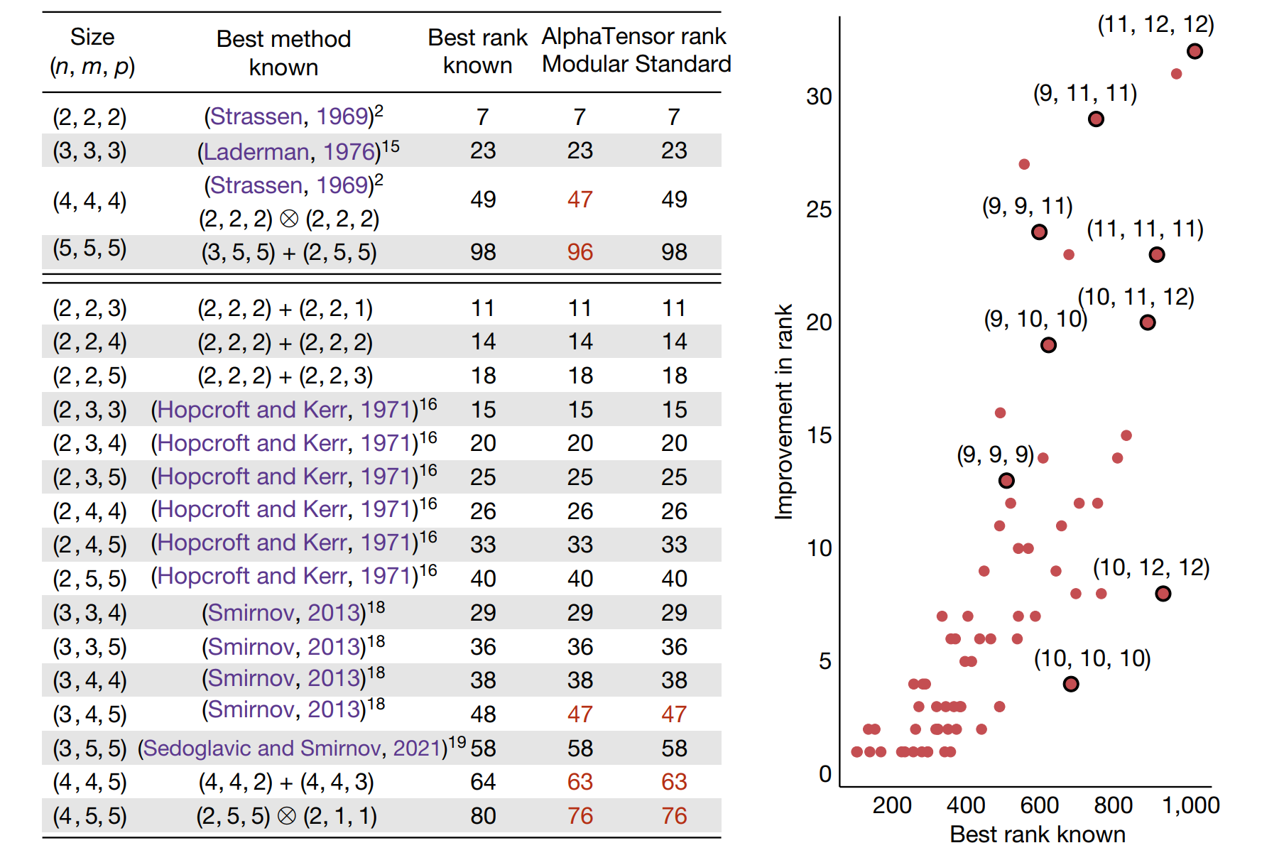

Slide 27
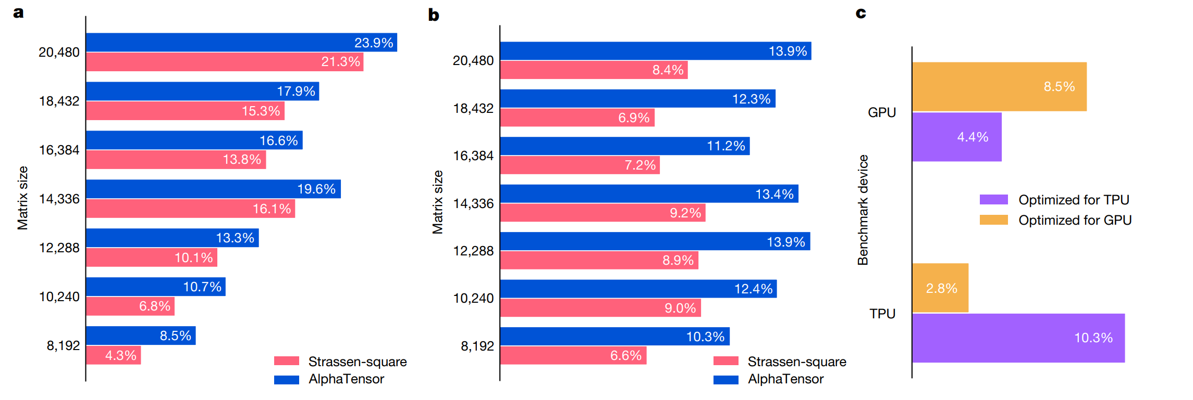

Slide 28
Overview
Acceleration
PlenOctrees
Plenoxel
TensoRF
Instant-NGP
Mobile NeRF
NeRF in the Dark
Ref-NeRF
NeRF in the Wild
PhasoRF

Slide 29

NeRF in the Dark: High Dynamic Range View Synthesis from Noisy Raw Images

Slide 30
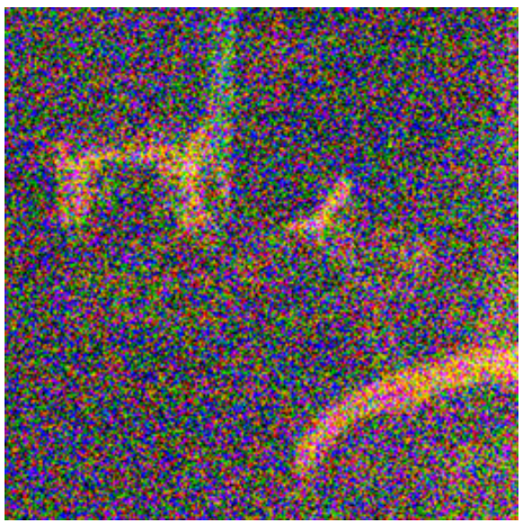
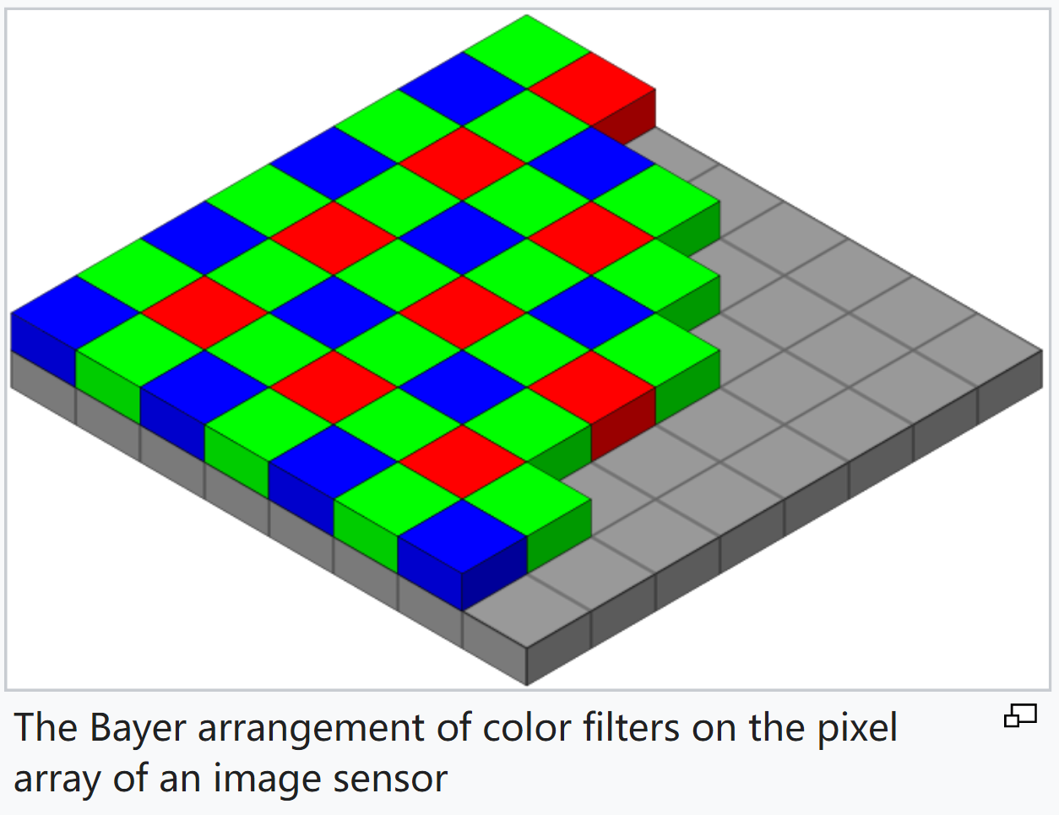
Recap: Camera postprocessing pipeline
A high bit-depth digital signal (typically 10 to 14 bits).
Offset by a “black level” (result here is used to train RawNeRF)
Demosaicking
Color correction and white balance
Gamma compression and tonemapping

Slide 31
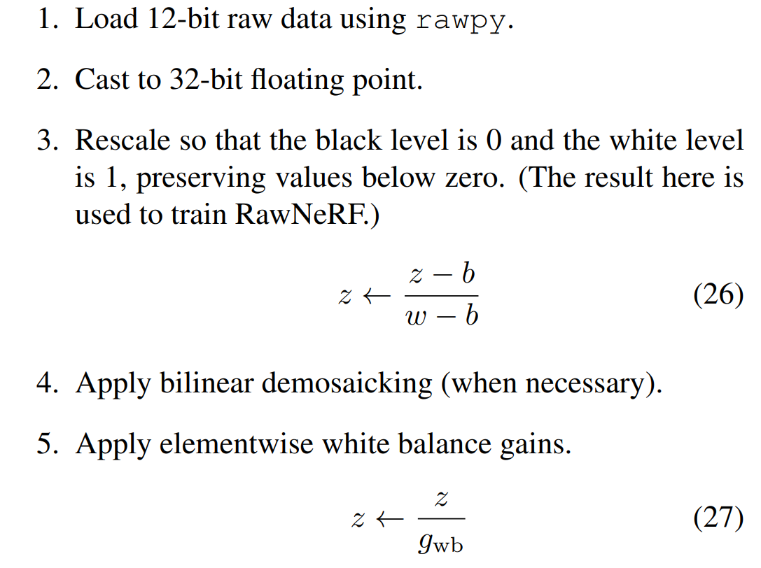
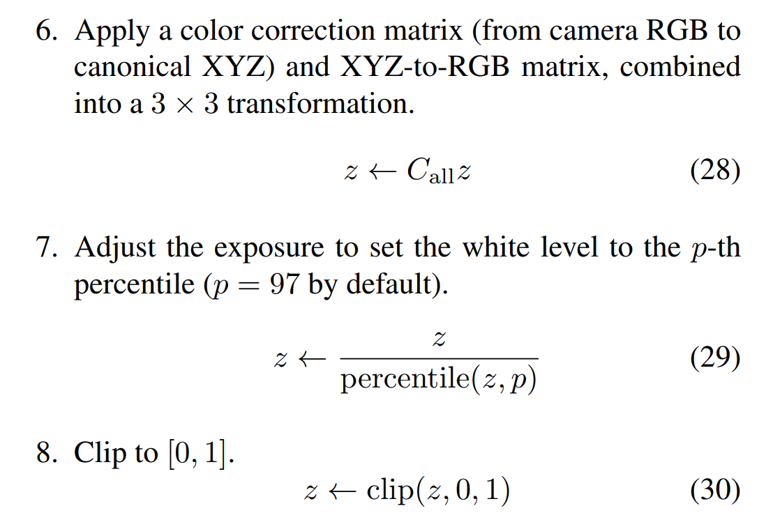
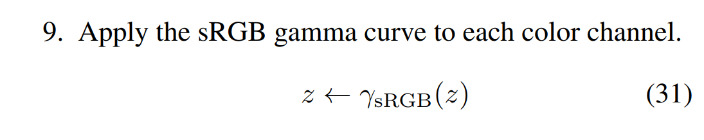
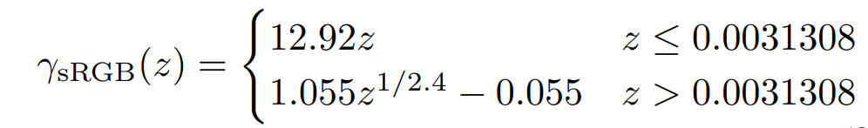
Example: Camera postprocessing pipeline

Slide 32
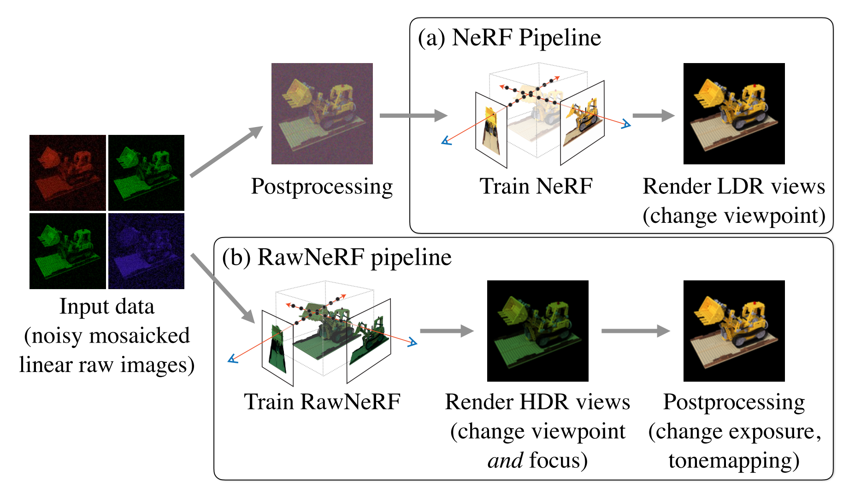
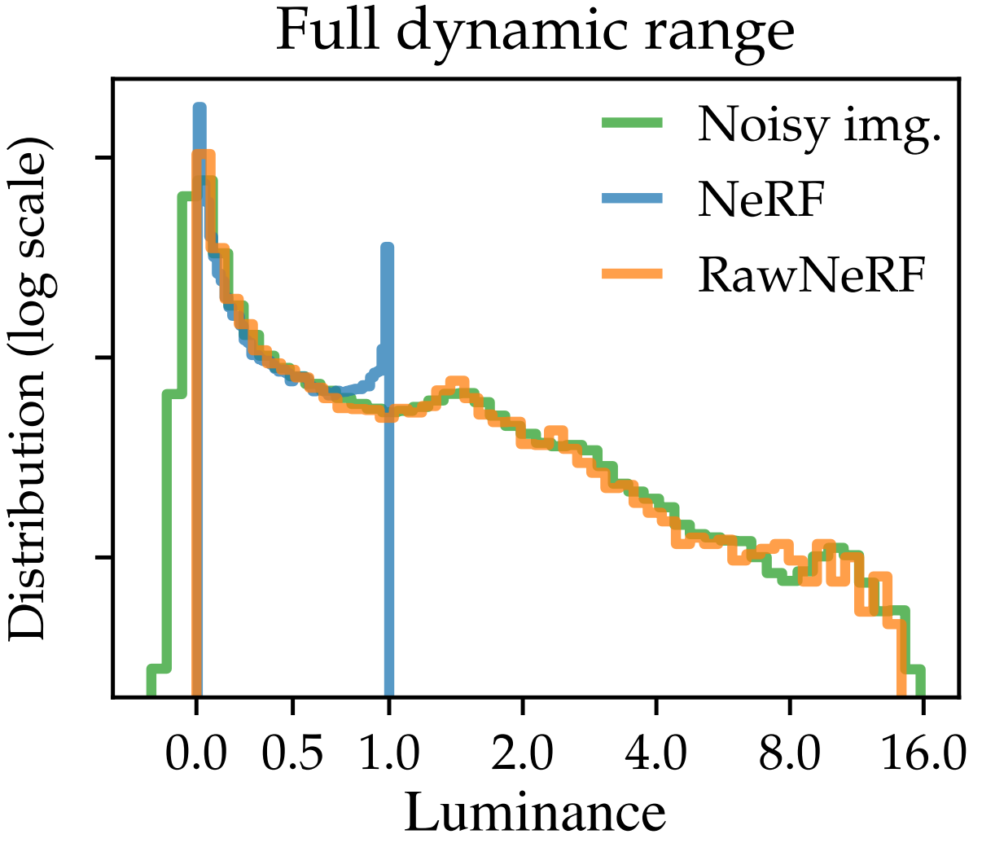
RawNeRF

Slide 33
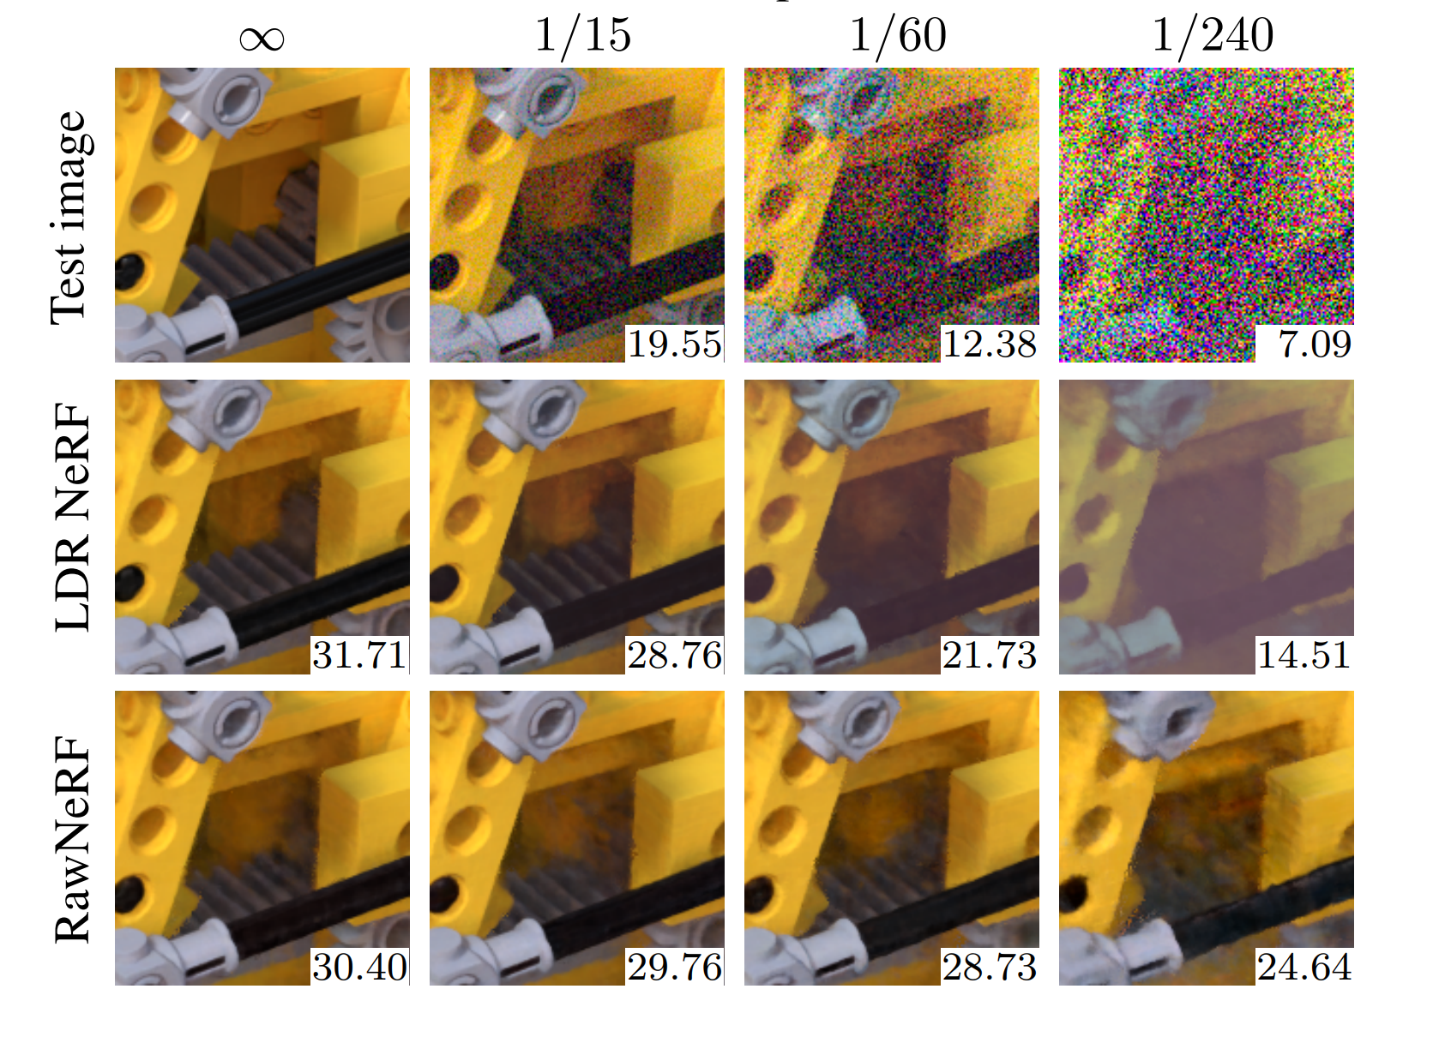
Result

Slide 34
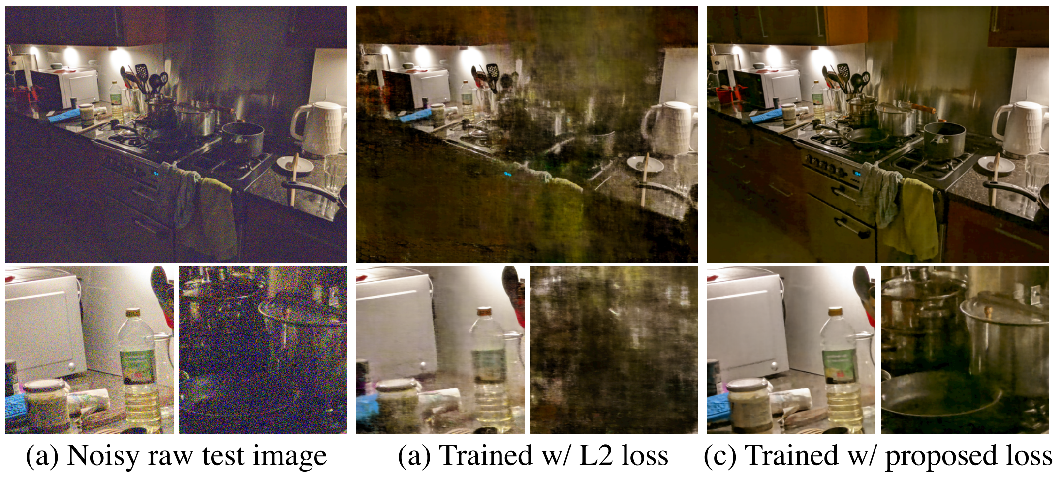
Loss function

Slide 35
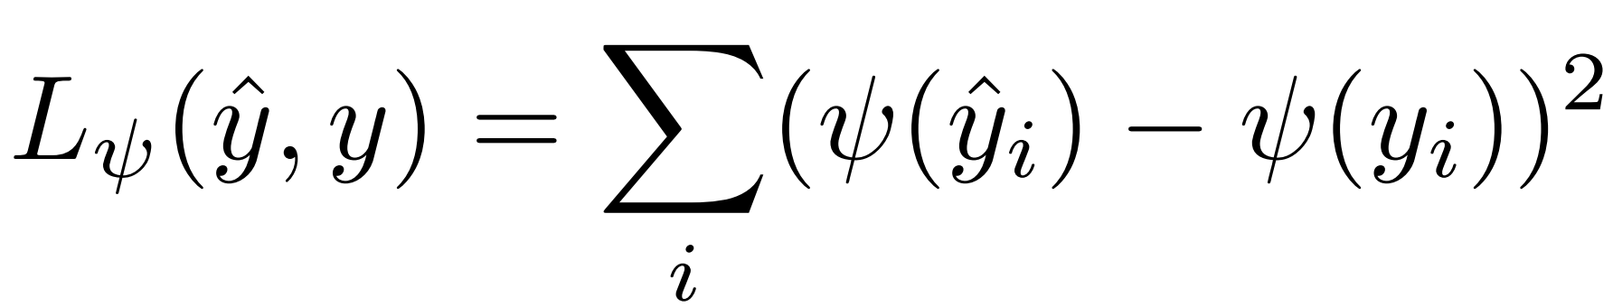
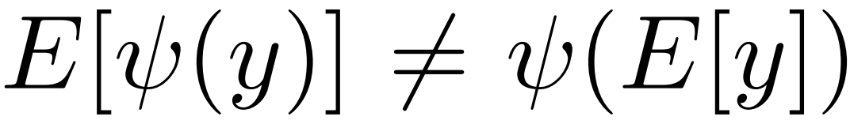
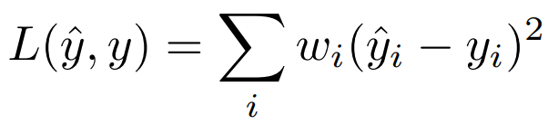
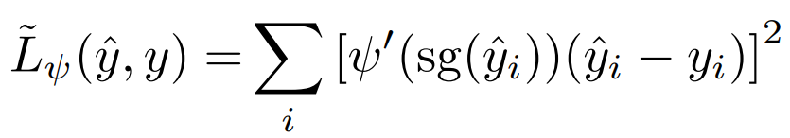
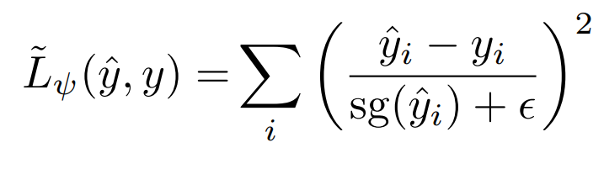
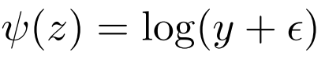
Loss function

Slide 36
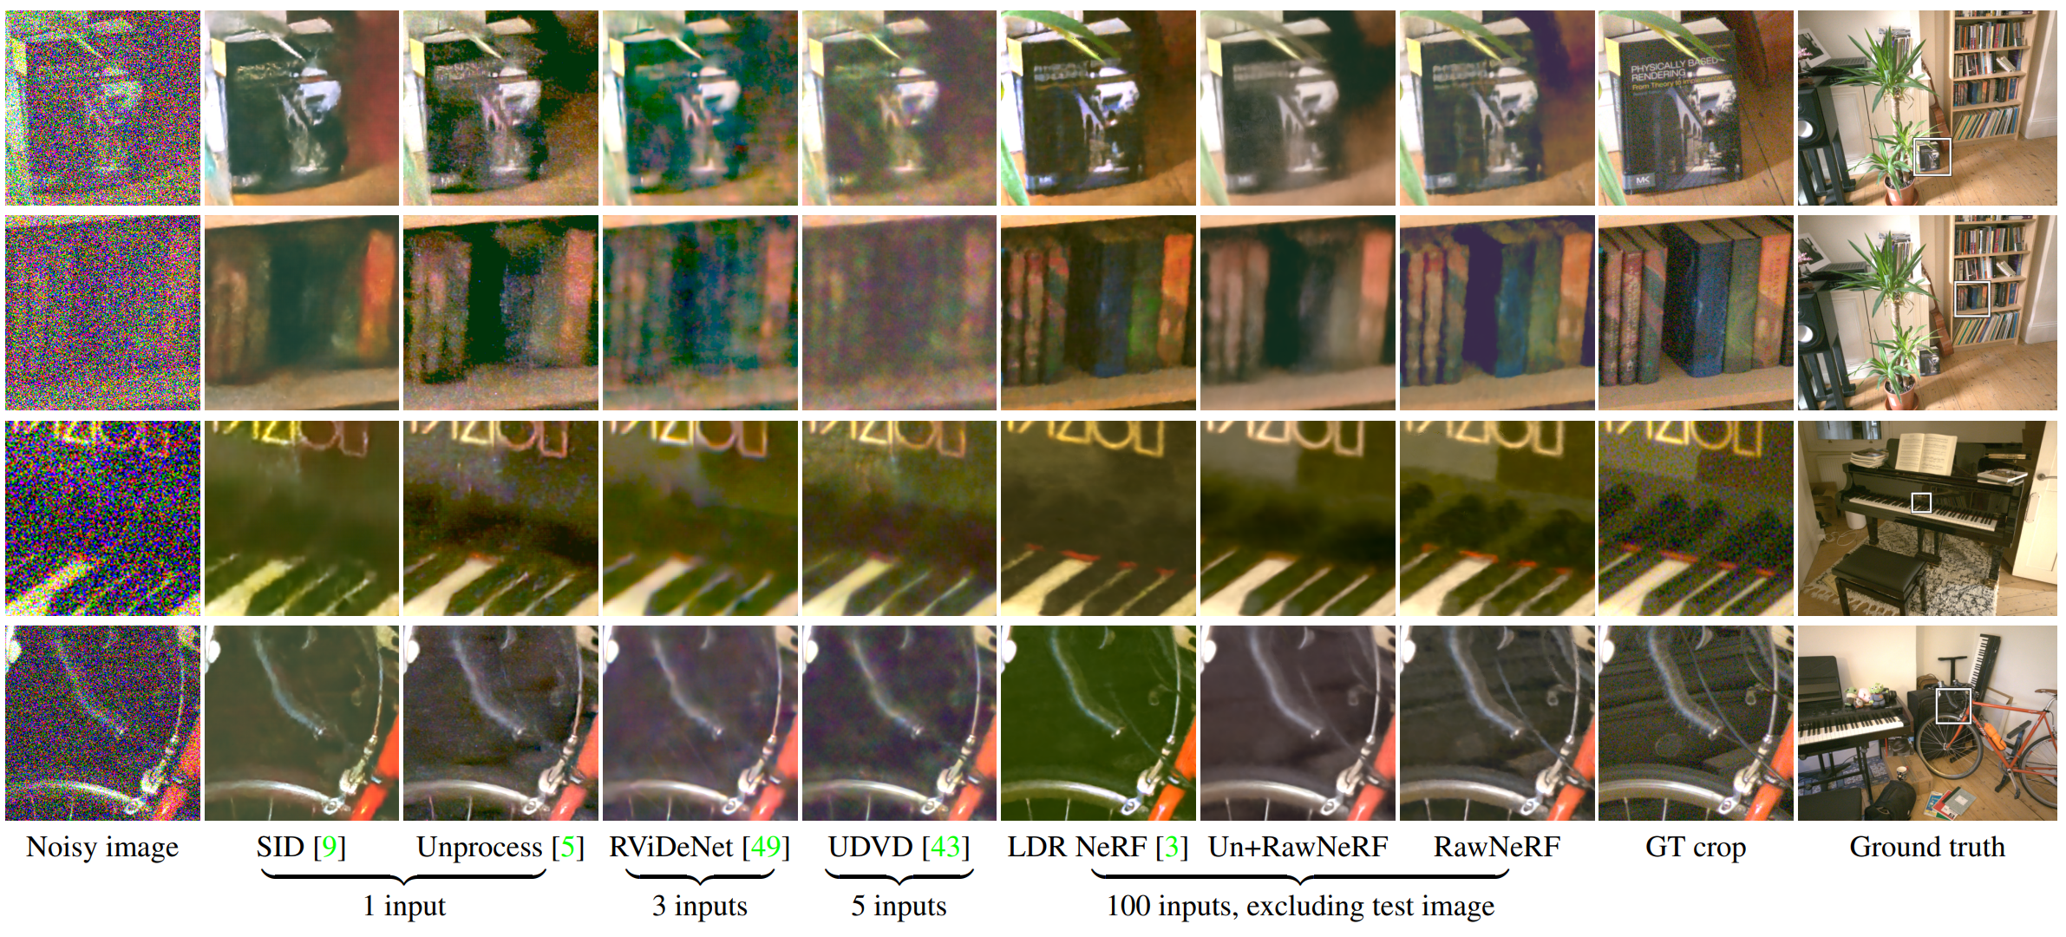
Result

Slide 37
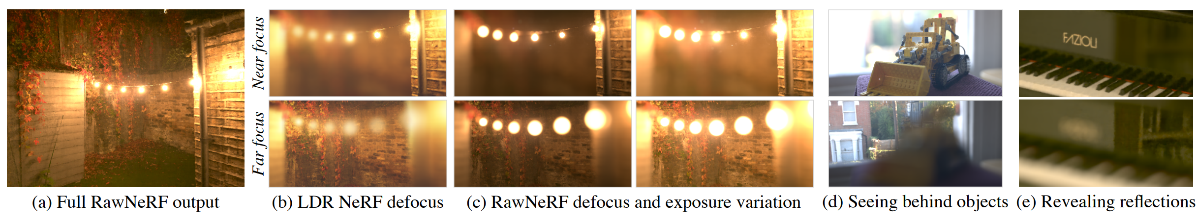
Result

Slide 38
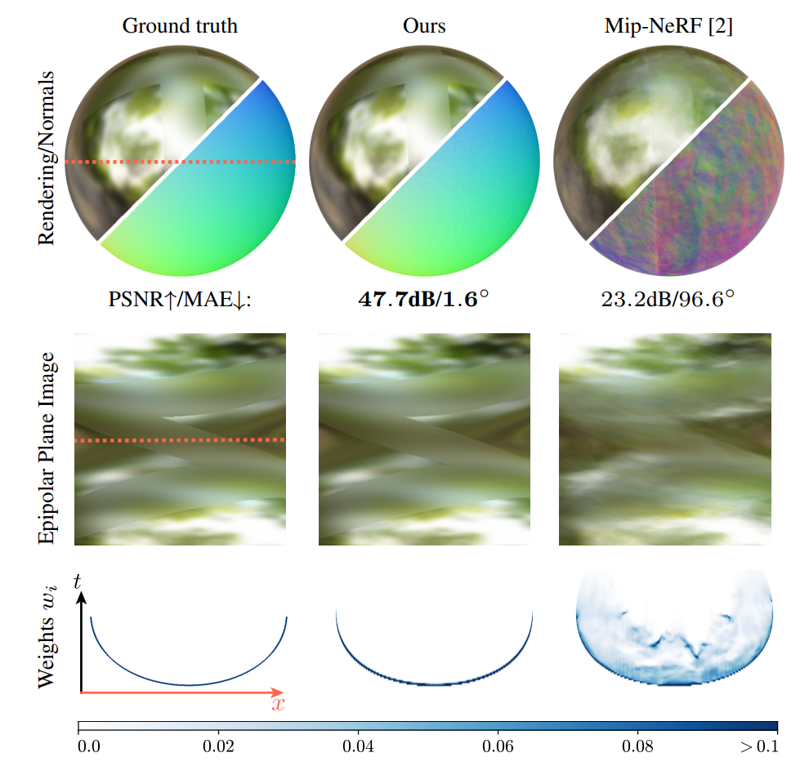
Ref-NeRF: Structured View-Dependent Appearance for Neural Radiance Fields

Slide 39
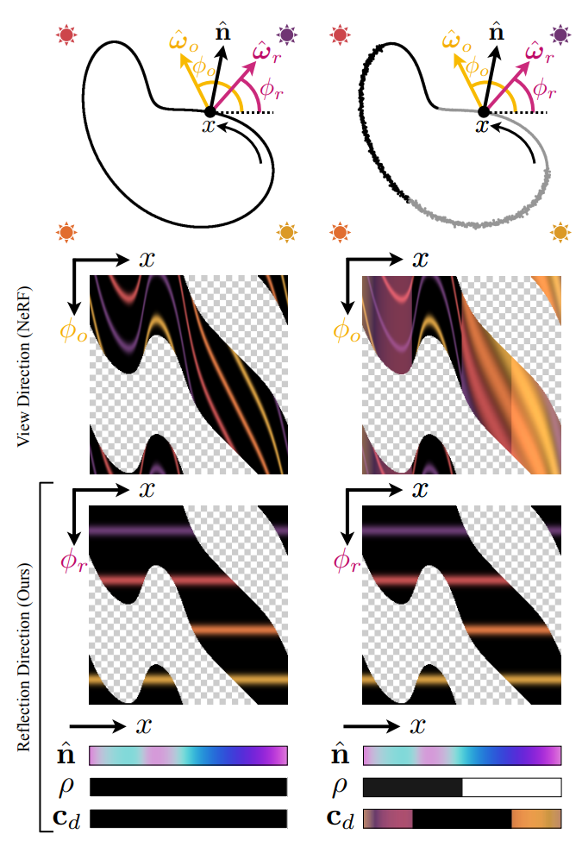
Ref-NeRF

Slide 40





Ref-NeRF

Slide 41



Roughness

Slide 42

Roughness

Slide 43


Accurate Normal

